Slide 1

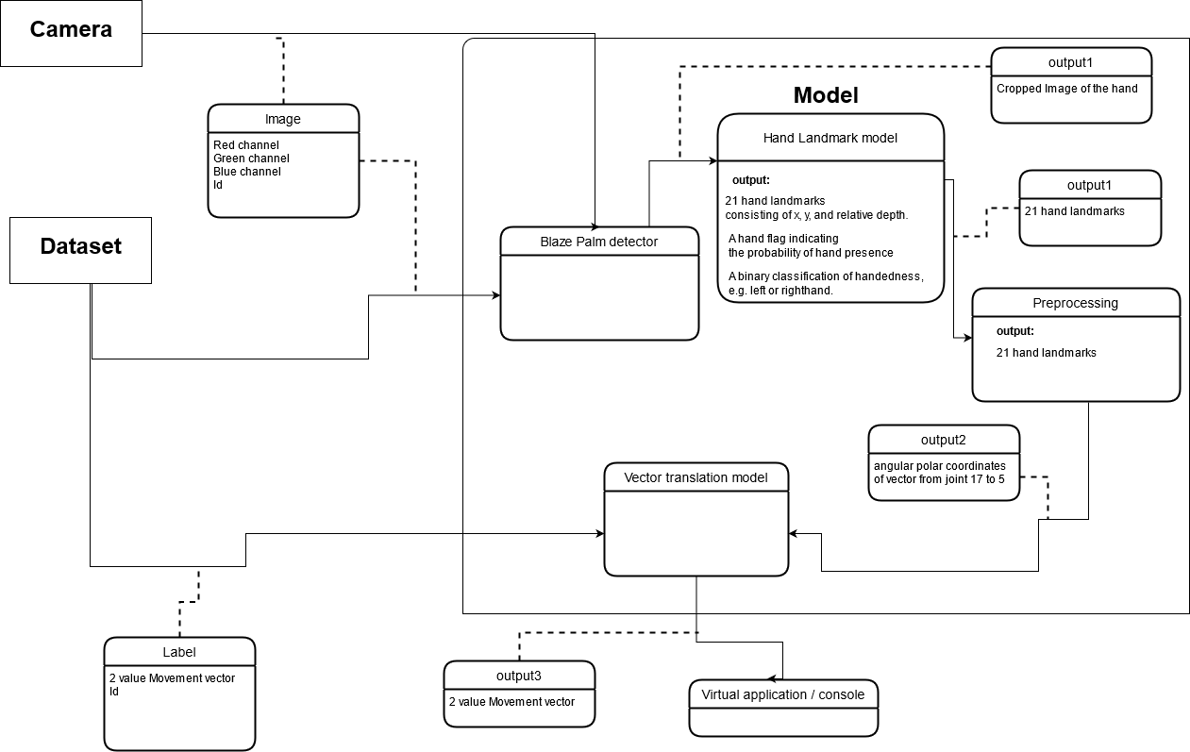
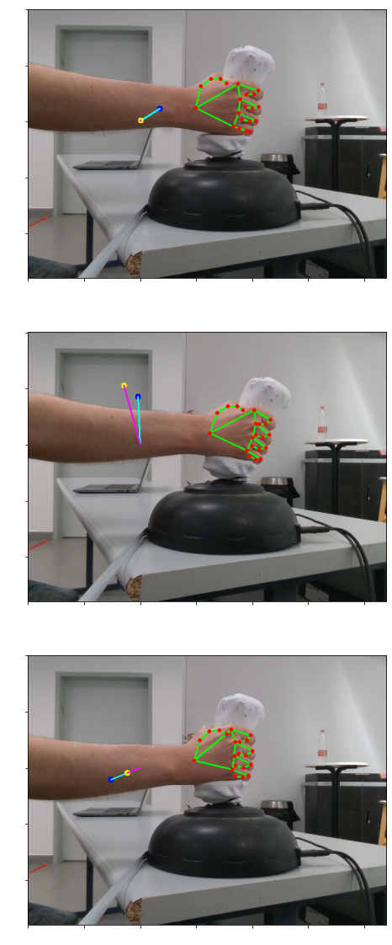
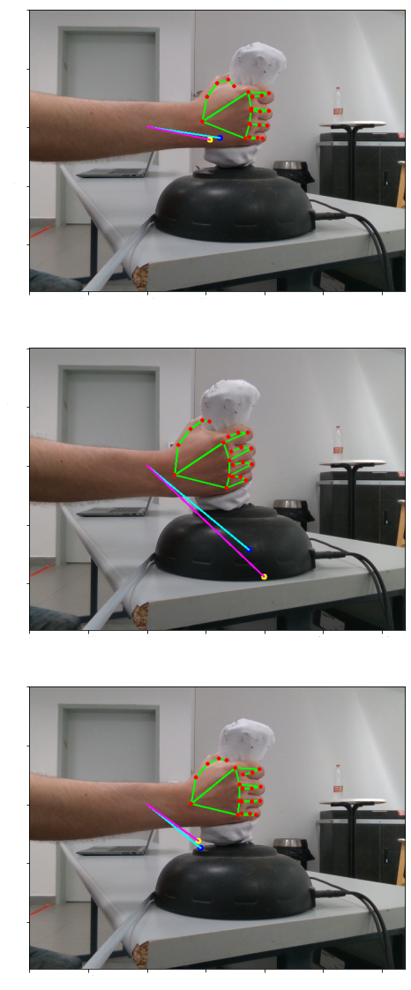
Nir Ben Dor, Daniel Kornis
Advisor: Mr Ehud Dayam
Software Engineering
Handy
Primary Design:
Project Results:
Handy is a cross-platform software which utilized Machine Learning models and real-time hand tracking algorithms in order to replace the use of joystick controllers with the user’s own hands. Handy is designed to create a better integration between human and virtual environments without relying on expensive external hardware.
Primary requirements:
The software will accept a live input-stream of RGB Images that will contain the user’s hand.
The images will be processed using two neural networks
The system will produce a predicted 2d coordinates for the joystick along with a 3d vector of 21 hand landmarks
Products:
Proof-Of-Concept version of the software, available to use after a simple setup.
Elaborate documentation for all software packages and algorithmic components comprising the system.

